Slide 1

EXPLORATORY DATA ANALYSIS
Team Name : CodeX
Team Leader : Ankit Gupta
Team Members : Hritik Sachdeva | Yatharth Nakul
College : SRM Institute of Science and Technology

Slide 2
PROBLEM STATEMENT
The objective is to perform exploratory data analysis on crime against women during the year 2001-2014 to predict the future requirements for women's safety and to provide a software solution to safeguard the women from the unlikely violence against them in society.

Slide 3

INTRODUCTION
Over the last few decades, India has witnessed phenomenal growth. In spite of all development and growth, women are still victims of horrendous crimes.
Crimes like rape, dowry death, domestic violence, kidnapping, molestation, torture, sexual harassment are experienced by women in India. Crimes have physical and psychological impact on women which preventing the ladies from leading a standard life. Crimes against women harm families and communities across generations and reinforce other evils prevalent in society.
Violence against women is perhaps as old as mankind. In India, not only in rural areas but also in urban areas, women are facing lot of problems. Crimes against women are happening because of inappropriate legal justice system, justice & law don’t go hand in hand and corrupted structure.

Slide 4



TOOLS AND TECHNOLOGY
Language
Python
Software Used
Jupyter Notebook
Pycharm
Libraries Used for Data Analysis
NumPy
Pandas
Matplotlib
Seaborn

Slide 5

SOLUTION
Through the Exploratory Data Analysis, our goal is to strengthen women's safety and spread awareness about crimes against women.
Moreover, we will be providing a software solution that will also contribute towards the security of women.

Slide 6
Time-Series Analysis of Crimes During the Year 2001 - 2014

Slide 7
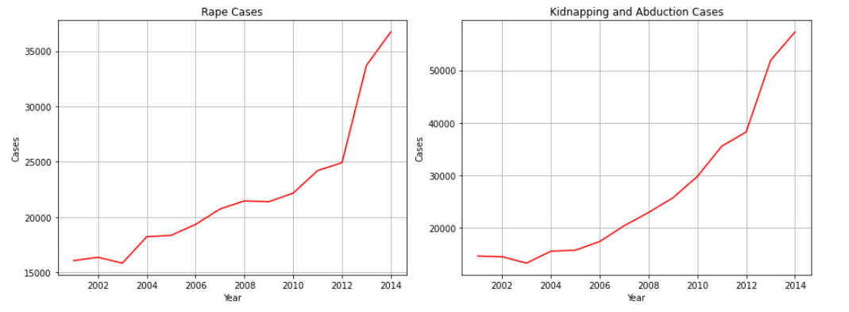
Rape
* Number of cases have increased over time.
* There is a dip in number of cases in year 2002-2003.
* Highest jump can be seen in year 2012-2013.
Kidnapping and Abduction
* There is a constant rise in the number of cases.
* A significant rise in the number of cases have been noticed in the years 2012-2014.

Slide 8
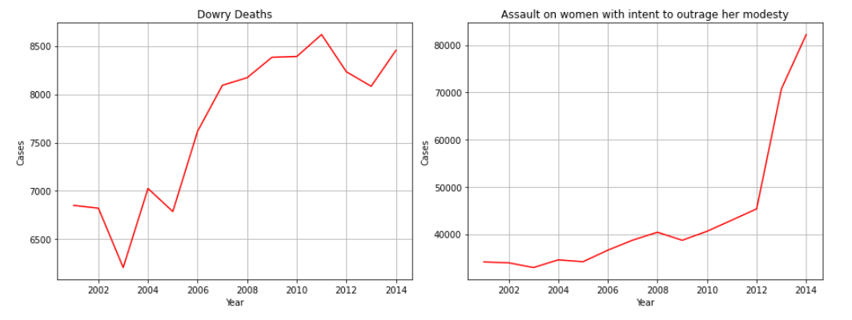
Dowry Deaths
* Number of Dowry Deaths cases have decreased in years 2001-2003,2004-2005 & 2011-2013.
* There has been a significant rise from the year 2005-2011 and 2013-2014.
Assault on women with intent to outrage her modesty
* A slight decrease in number of cases can be seen in the years 2001-2003 and 2008-2009
* A steep rise is seen from the year 2012-2014

Slide 9
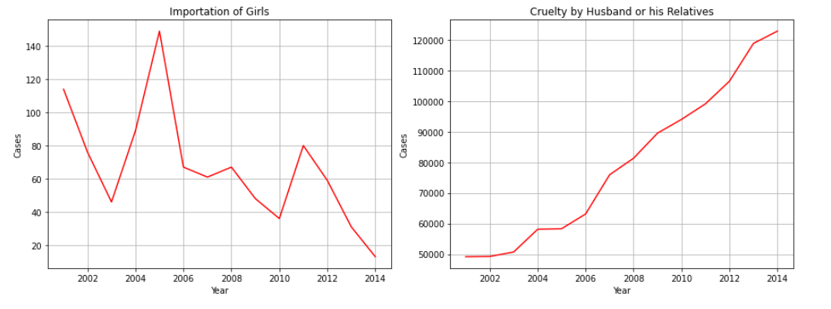
Importation of Girls
* There has been a noticeable rise in number of cases during the years 2003-2005 and 2010-2011
* Overall number of cases has been reduced over time.
Cruelty by Husband or his Relatives
* Crimes under 'Cruelty by Husband or his Relatives' has continuously increased over time

Slide 10
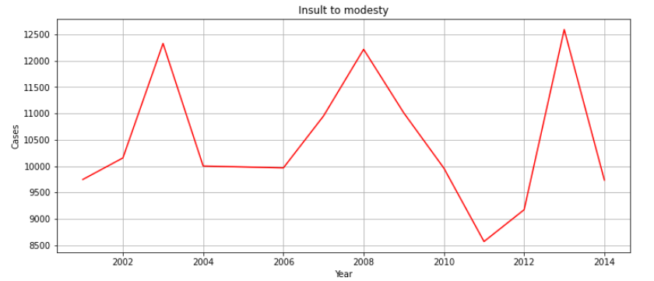
Insult to Modesty
* Number of cases of Insult to modesty of women is fluctuating throughout the years.

Slide 11
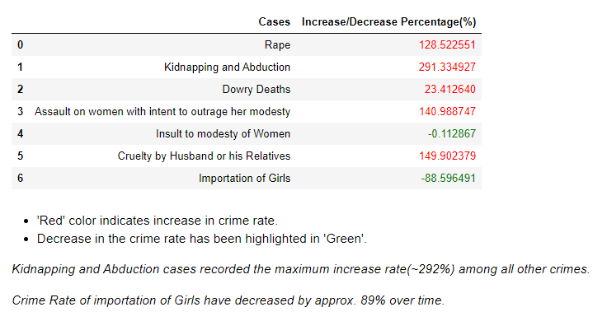
Insights
'Red' colour indicates increase in crime rate.
Decrease in the crime rate has been highlighted in 'Green'.
Kidnapping and Abduction cases recorded the maximum increase rate(~292%) among all other crimes.*
Crime Rate of importation of Girls have decreased by approx. 89% over time.*

Slide 12
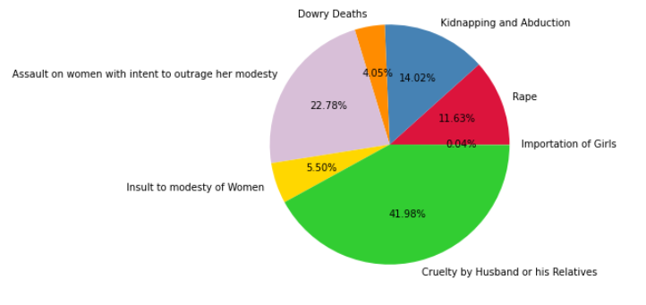
Total Crime Rate Distribution
* Cruelty by Husband or his Relatives accounts for nearly half(42%) of all the crimes against women.
* Importation of Girls has the least rate i.e. 0.04% among all other crimes against women throughout all the years.

Slide 13
State wise Analysis of Crimes Against Women

Slide 14
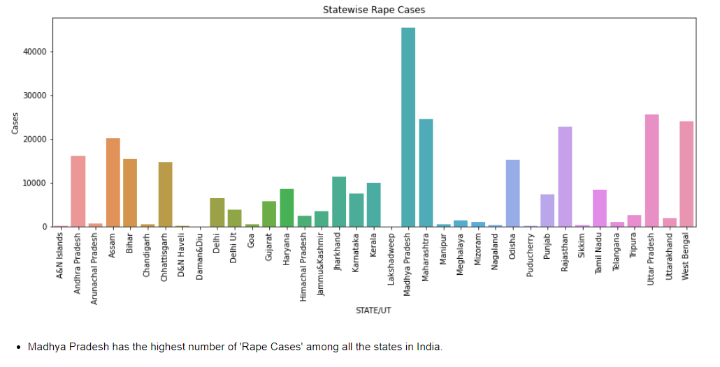

Slide 15
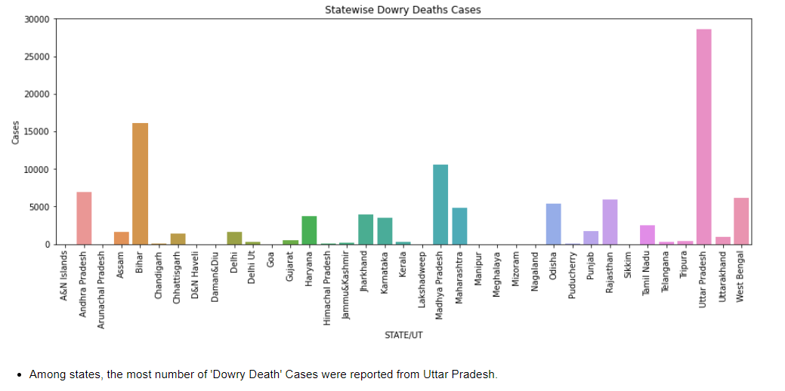

Slide 16
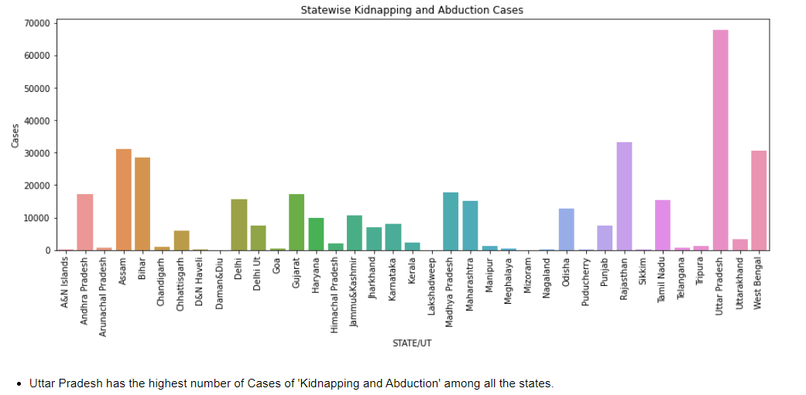

Slide 17
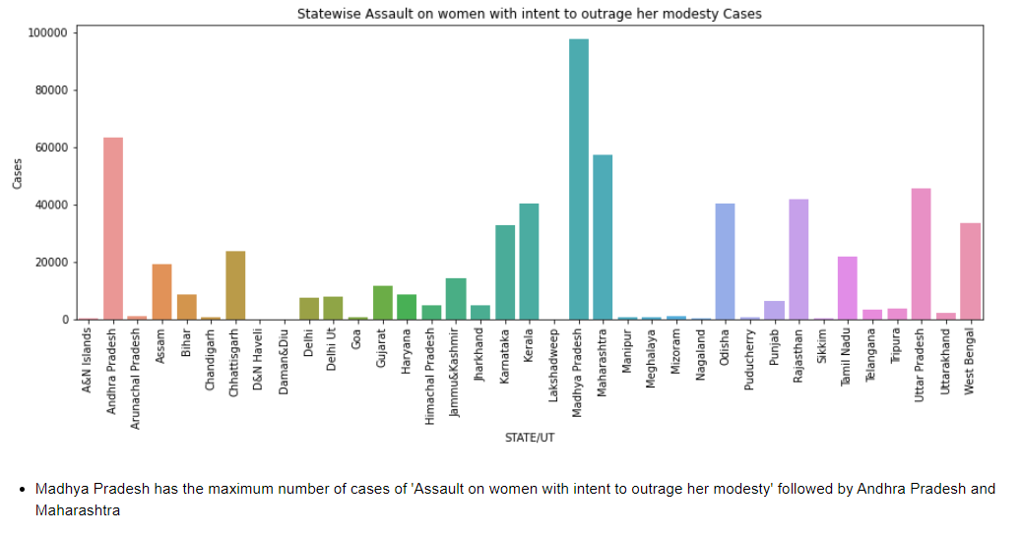

Slide 18
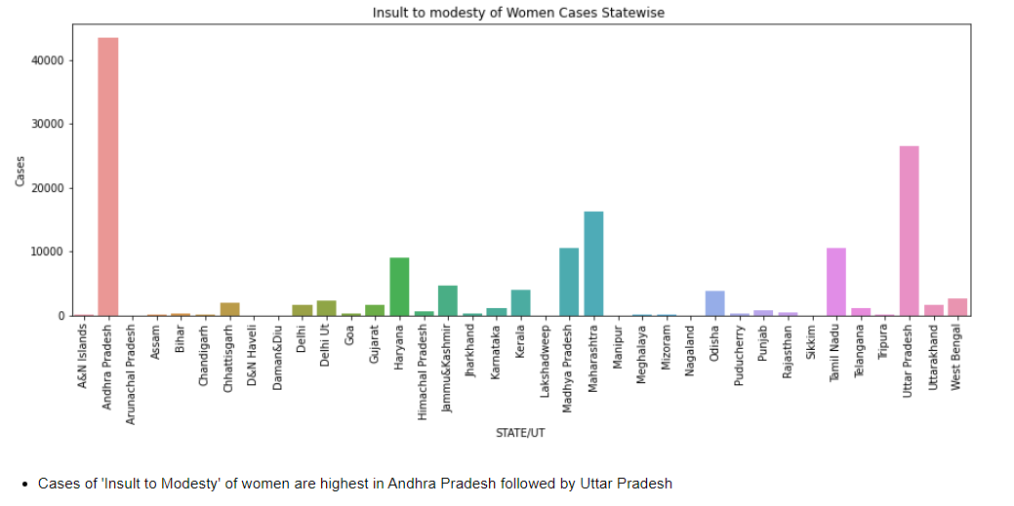

Slide 19
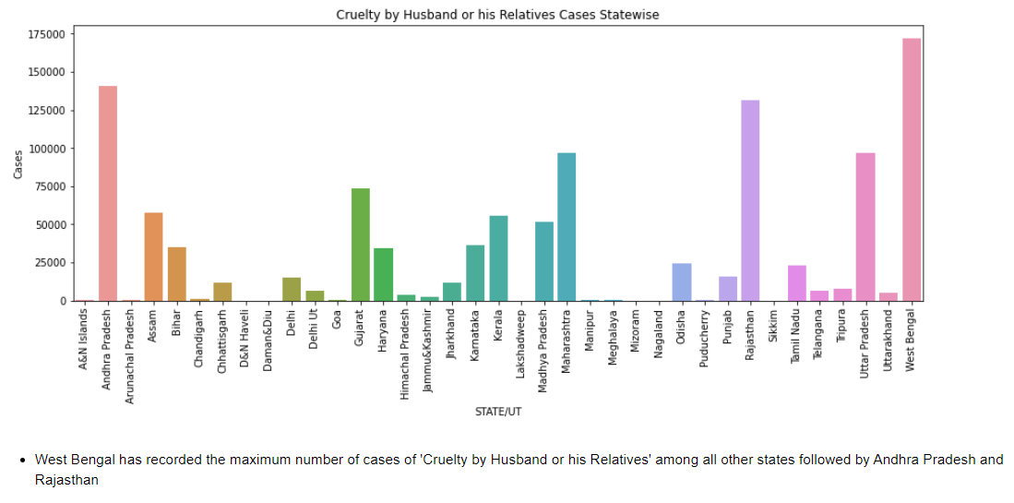

Slide 20
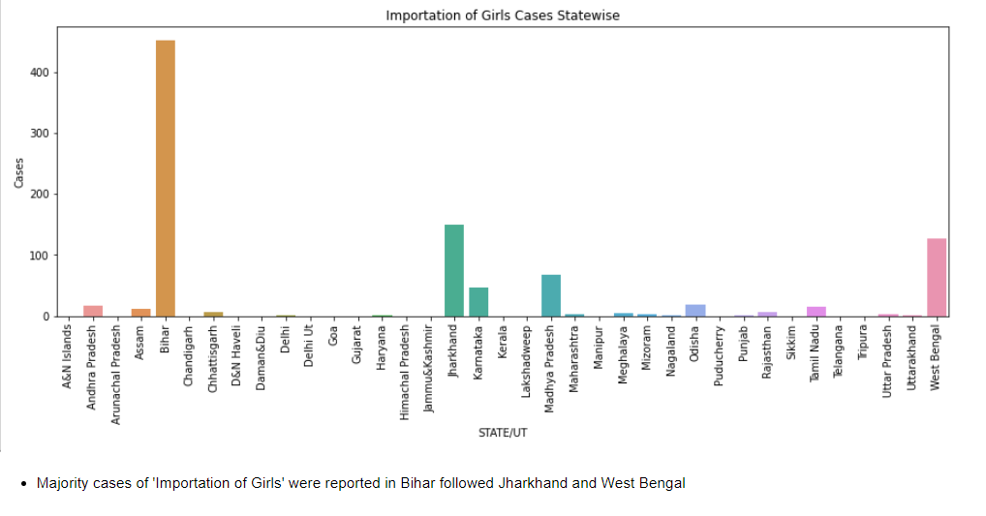

Slide 21
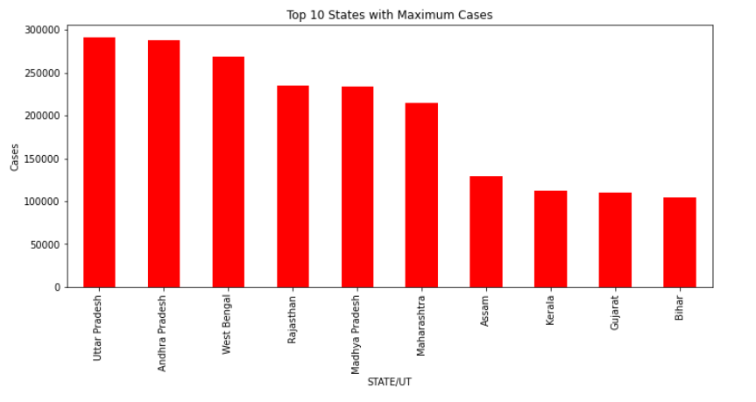
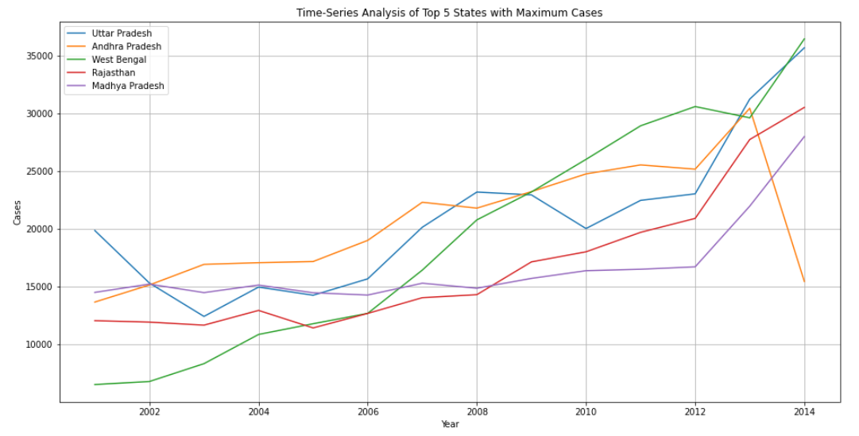
Top 10 States with Highest Crime Rate
Uttar Pradesh holds the worst record by laying claim to nearly 300000 cases of crime against women among top 10 states with highest crime rate in the country followed by Andhra Pradesh, West Bengal, Rajasthan & Madhya Pradesh.
Crime rate has been increased over time in all the states.
Significant dip of crimes against women is noticeable in Andhra Pradesh from year 2013-2014.

Slide 22
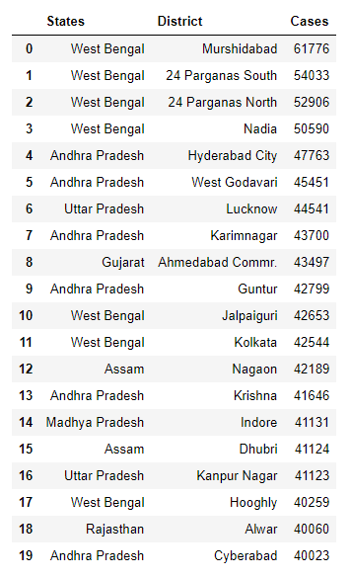
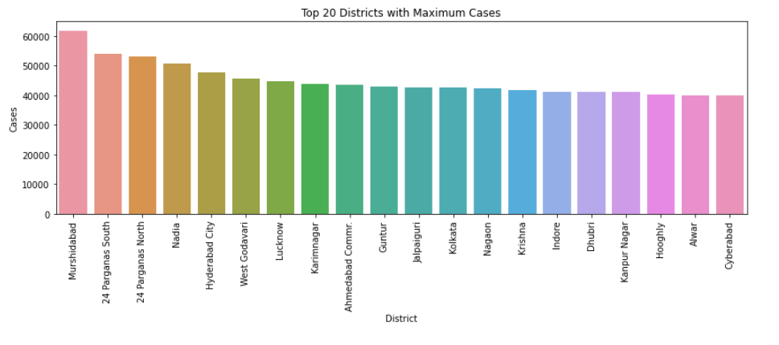
Top 20 Districts with Crimes against Women
Murshidabad, district in West Bengal, has reported the maximum number of cases against women among all the districts

Slide 23




SOFTWARE SOLUTION
Features :-
Emergency Buzzer
Email Access
Voice Recognition
Date and Time
WhatsApp Access
A software solution is a prototype for women’s safety. When software is initiated with a “help” voice command, an emergency message(“HELP! I AM IN DANGER! I NEED HELP!!!”) will be sent to specific contacts through e-mail and WhatsApp.
A loud alarm is also raised to catch the attention of the people nearby.
HELP!!

Slide 24
THANK YOU

